Slide 1
WP7 Overview

Slide 2
Mail Goals
Standardization
Dissemination
Exploitation
Expected results
· Exploitation Plan (based on the optimal Business Model) in order to reach the desired market(s).
· A Dissemination Plan.
· Report on standardization activities.
· ModelWriter-ITEA consortium project website.

Slide 3
T7.1 - Dissemination Plan
Obeo + UNIT + SA + LORIA + KS + ALL
communication strategy and indicating the list of schedules activities
wording elements different for each community

Slide 4
T7.2 – Business Model & Exploitation Plan
Airbus + SA + Obeo + all industrial partners
(1) Vision and strategic approach;
(2) Product and services analysis;
(3) Market analysis;
(4) Commercial strategy;
(5) Implementation;
(6) Management issues;
(7) Financial plan
sales channel to all ModelWriter’s providers
End Users will provide analysis of ROI of ModelWriter for target the good price and the optimal commercial offer.
Business Model around Open Source

Slide 5
T7.3 – Workshops & Events
VUB + UNIT + Obeo + KS + Airbus + ALL
organization of ModelWriter community
Communication of ModelWriter objectives, results and events
Standardized high quality dissemination material (brochures, newsletter, posters, videos, etc.)
Workshops and conferences
Academic or research publications
Newspapers and interviews

Slide 6
T7.4 – ModelWriter-ITEA Consortium Website
SA
Public web part
Nothing else (waffle, github, google docs, etc.)

Slide 7
T7.5 - Community Forum & Open Source Campaign
VUB + Obeo
What is reconfigurable text & model synchronisation?
Why is it useful?
How can we use it?
How has it been used already?
EclipseCon, Agile ALM Conference, Models

Slide 8
T7.6 – Social Networks
Unit + KS
· Facebook Group (D7.6.1)
· LinkedIn Group (D7.6.2)
· Twitter (D7.6.3)
· Yammer (D7.6.4)

Slide 9
T7.7 – Standardization
LORIA + UNIT + KS
ISO committees
ISO's TC37 “Computer Applications in Terminology”
SC4 "Linguistic resources management"
ISO/IEC/IEEE 29148:2011 and ISO/IEC/IEEE 42010:2011

Slide 10
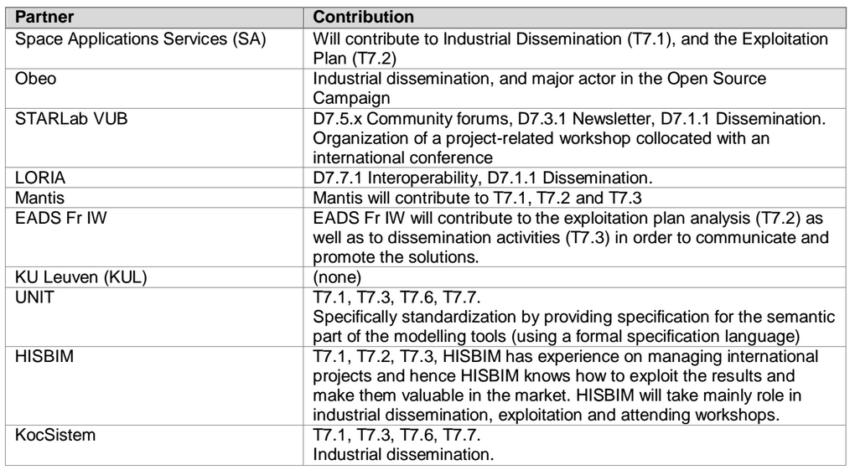
WP7 Contributions

Slide 11
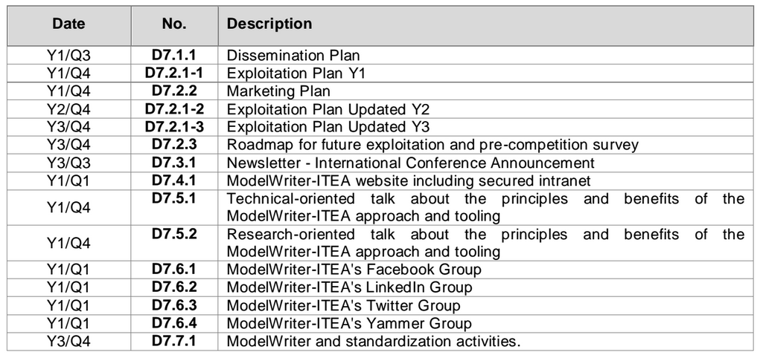
WP7 Deliverables

